Slide 1
CST2550 - 2025
Software Engineering and Management
Week 10: Software Design Patterns and Principles
Ahmed Eissa
a.eissa@mdx.ac.uk

Slide 2
Learning Objectives
Master SOLID principles for effective software design.
Understand the purpose and types of design patterns.
Learn to implement design patterns in C#.

Slide 3
1. SOLID Principles

Slide 4
Mastering SOLID Principles
SOLID principles are a set of five guidelines for object-oriented design.
They promote writing maintainable and scalable code by emphasising single responsibility, open/closed, and Liskov substitution principles.
Additionally, interface segregation and dependency inversion help developers create flexible, decoupled systems that are easier to test and extend
Single Responsibility Principle
This principle advocates that each class should have only one reason to change, increasing maintainability and clarity in code.
Open/Closed and Liskov Substitution
Classes should be open for extension but closed for modification, and derived types must be substitutable for their base types.
Interface Segregation and Dependency Inversion
Splitting interfaces and inverting dependencies builds flexible, decoupled systems that are easier to test and extend.
Notes:
Image source: Microsoft 365 content library
SOLID principles are a set of five guidelines for object-oriented design. They promote writing maintainable and scalable code by emphasizing single responsibility, open/closed, and Liskov substitution principles. Additionally, interface segregation and dependency inversion help developers create flexible, decoupled systems that are easier to test and extend.

Slide 5
Single Responsibility Principle (SRP)
Concept:
  A class should only have one reason to change.
Why It Matters:
  Encourages cohesion.
  Simplifies debugging and maintenance.
Examples:
  A “ReportGenerator” class should focus solely on creating reports, not handling file saving.
  Source code is in next slide.

Slide 6
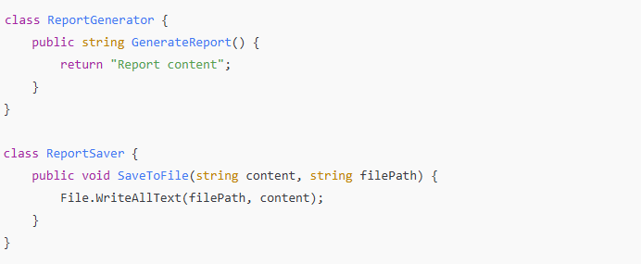
Single Responsibility Principle (SRP)

Slide 7
Open/Closed Principle (OCP)
Concept:
  Software entities should be open for extension but closed for modification.
Implementation:
  Use abstract base classes or interfaces to allow extension.
  Avoid altering existing code when adding new functionality.

Slide 8
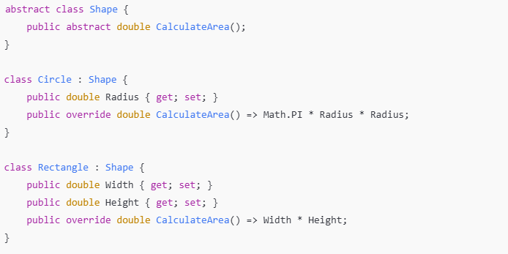
Open/Closed Principle (OCP)

Slide 9
Interface Segregation Principle (ISP)
Concept:
  A class should not be forced to implement interfaces it does not use.
Solution:
  Break large interfaces into smaller, more specific ones.

Slide 10
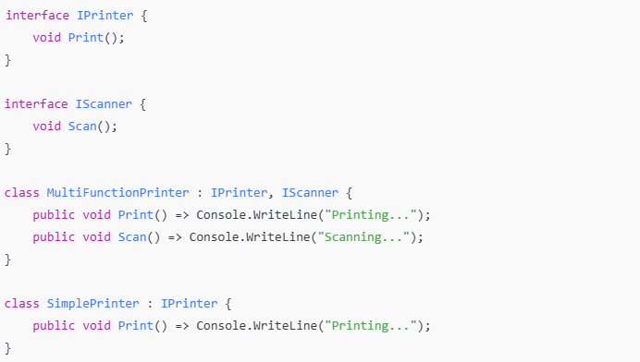
Interface Segregation Principle (ISP)

Slide 11
2. Design Patterns

Slide 12
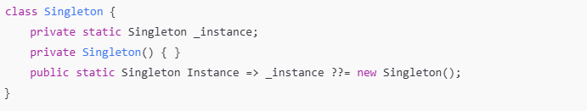
Creational Patterns
Purpose:
  Manage object creation, ensuring flexibility and reusability.
Example:
  Singleton Pattern.
  Ensures a class has only one instance and provides a global point of access.
Example:

Slide 13
Structural Patterns
Purpose:
  Simplify the design by identifying a simple way to realise relationships between entities.
Example:
  Adapter Pattern.
  Converts the interface of a class into another interface clients expect.

Slide 14
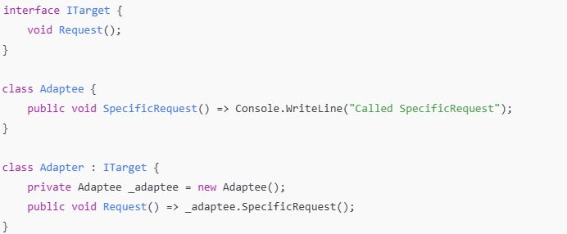
Structural Patterns

Slide 15
Behavioural Patterns
Purpose:
  Focus on communication between objects.
Example:
  Observer Pattern.
  Defines a dependency between objects, so when one changes state, others are notified.

Slide 16
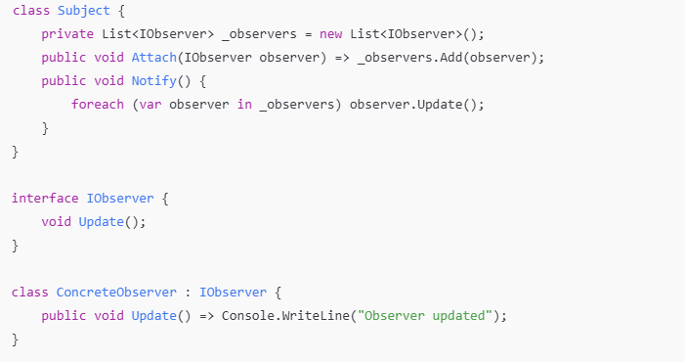
Behavioural Patterns

Slide 17
3. Practical Examples

Slide 18
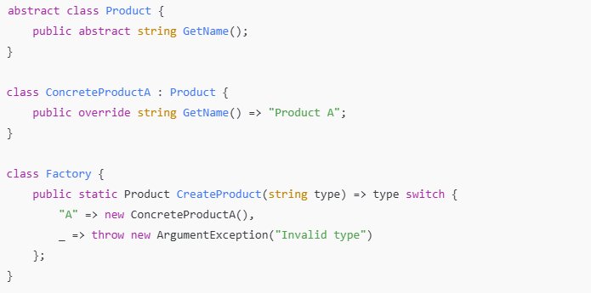
Example 1: Factory Pattern
Purpose: Abstracts the creation logic of objects.

Slide 19
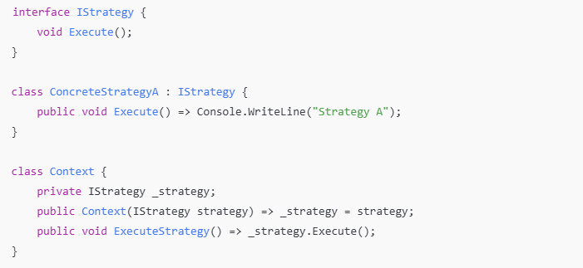
Example 2: Strategy Pattern
Purpose: Define a family of algorithms and make them interchangeable.

Slide 20
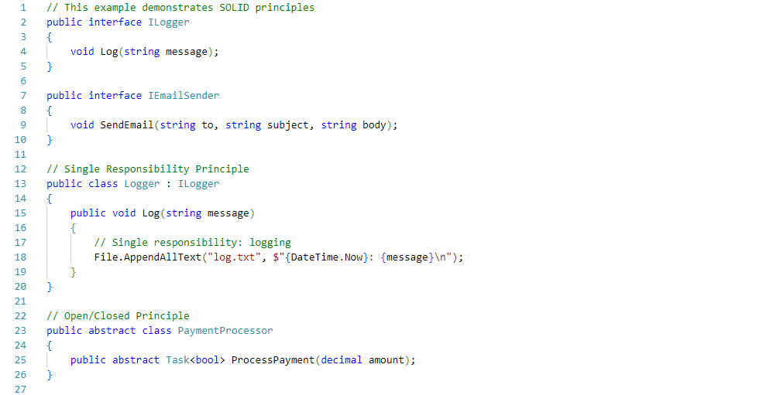
Example 3: SOLID Principles
Implementation

Slide 21
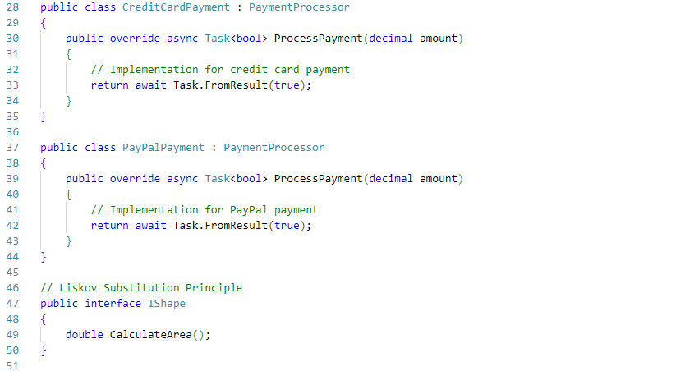
Example 3: SOLID Principles
Implementation

Slide 22
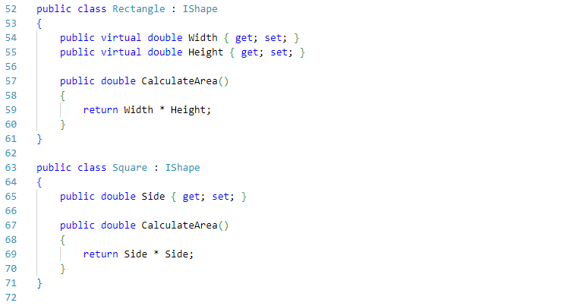
Example 3: SOLID Principles
Implementation

Slide 23
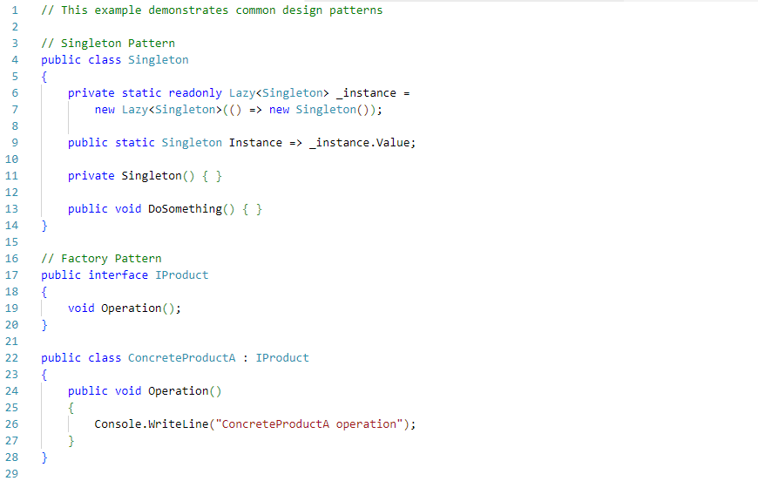
Example 4: Design Patterns
Implementation

Slide 24
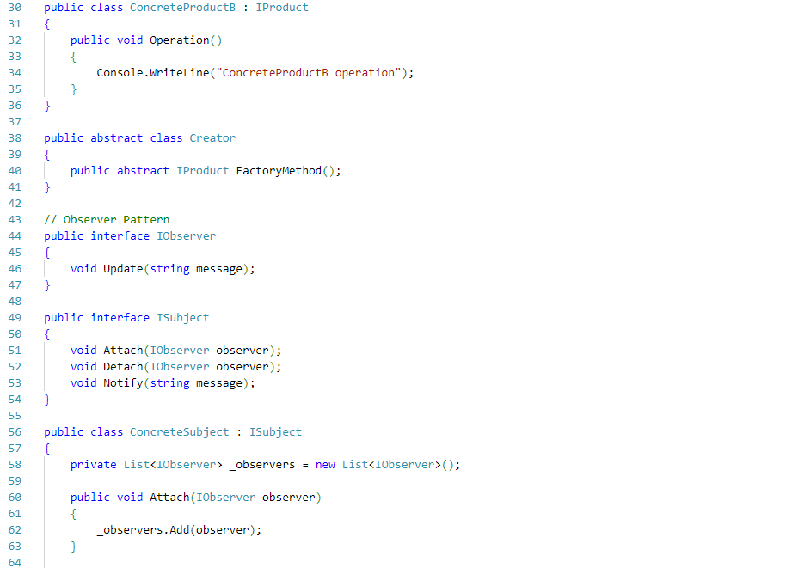
Example 4: Design Patterns
Implementation

Slide 25
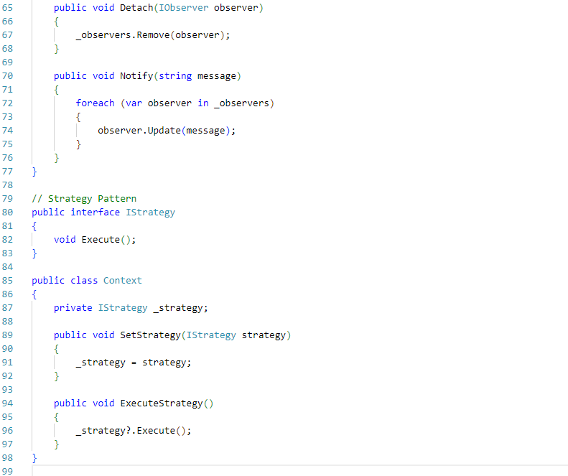
Example 4: Design Patterns
Implementation

Slide 26
Practice Exercises
1. SOLID Principles
  Refactor code to follow SOLID
  Identify violations
  Implement improvements
2. Design Patterns
  Implement multiple patterns
  Combine patterns
  Create real-world examples

Slide 27
Further Reading
Books:
  "Design Patterns: Elements of Reusable Object-Oriented Software" by Gamma et al.
  "Clean Code: A Handbook of Agile Software Craftsmanship" by Robert C. Martin.
  Design Patterns Book (Gang of Four)
Online Resources:
  Refactoring Guru - Design Patterns
  SOLID Principles by GeeksforGeeks
  C# Design Pattern Examples
Tools:
  Visual Studio Code snippets for design patterns.
  Online design pattern playgrounds (e.g., Dofactory).

